Slide 1


Introduction to Algorithms-Definition, characteristics, real-world examples Session No.: 1 Course Name: Design and analysis of algorithm Course Code: R1UC407B Instructor Name: Rakesh Bharati Duration: 50 Min. Date of Conduction of Class:

Slide 2

Review of the key concepts 1.Basic concepts of data structure 2. Searching algorithm 3. Sorting Algorithm

Slide 3
Q1: What do you understand by the term algorithm? Q2: What is meant by input and output of an algorithm?
Opening Question

Slide 4
Learning Outcome
Define an algorithm and explain its role in problem solving.
Applies algorithmic thinking to real-world problems.

Slide 5
Session Outline
1 Introduction to notion of an algorithm,
2 Fundamentals of algorithmic problem solving and problem types
3 Concept and definition for learning Activity
4 Activity (scenario based)
5 Reflection learning activity
6 Conclusion

Slide 6
Definition
An algorithm is a combination of sequence of finite step to solve a any particular problem.

Slide 7
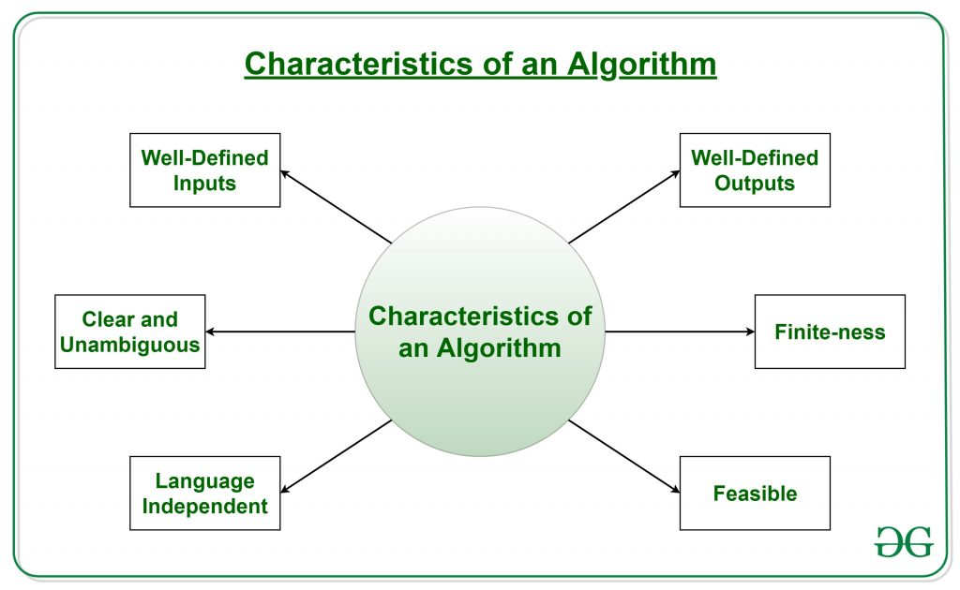
Characteristics of an algorithm

Slide 8
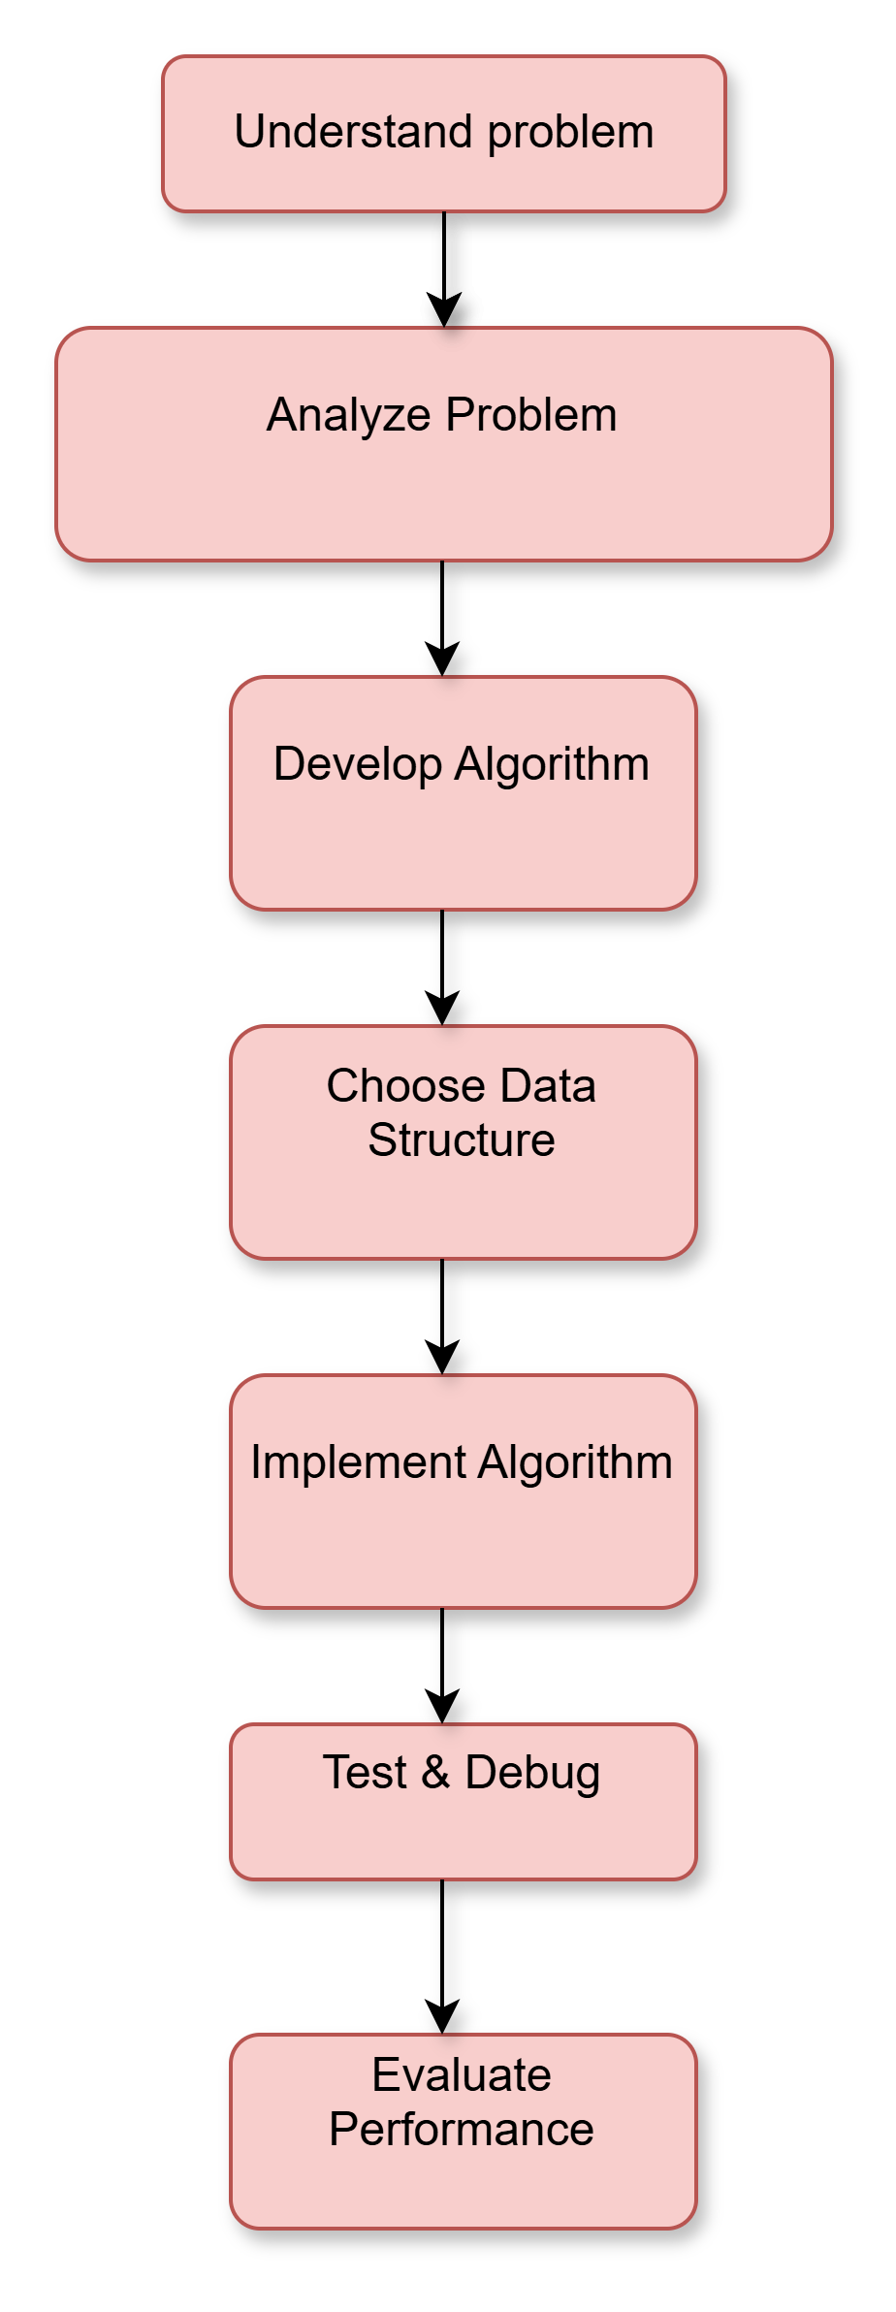
Fundamentals of Algorithmic Problem Solving
Algorithmic problem-solving is the process of designing and implementing a solution to a problem using a series of steps or rules.

Slide 9
Problem Types in Algorithmic Problem Solving
Decision Problems: Answer is Yes/No
Optimization Problems: Find the best solution
Search Problems: Find an element in a dataset
Computational Problems: Require mathematical computations

Slide 10

Activity1 (scenario based)

Slide 11
Activity-1 (scenario based)
Objective:
Students will understand the concept of an algorithm by creating step-by-step instructions to solve a problem in a real-world scenario.
Scenario:
Explain how to prepare a cup of tea so that even a robot (or a person who has never made tea before) can follow the instructions without confusion.

Slide 12
Reflection- This activity helped students understand that an algorithm must consist of clear, precise, and logically ordered steps to achieve a desired outcome.

Slide 13
Activity- 2 (Pen-Paper based)
Write an algorithm to find the sum of two numbers.

Slide 14
Summary An algorithm is a finite set of well-defined instructions designed to perform a task or solve a problem. Effective algorithmic problem solving involves understanding the problem, designing a clear solution strategy, and analyzing the algorithm's efficiency.

Slide 15
In the next session, Algorithmic problem-solving strategies, problem types

Slide 16
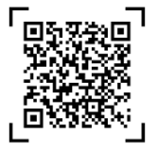
Review and Reflection from students

